Slide 1

Introduction of Android IPC - Binder
Xu Feng

Slide 2
WHAT
Binder is an Android-specific inter process communication mechanism, and remote method invocation system
  That is, one Android process can call a routine in another Android process, using binder to identify the method to invoke and pass the arguments between processes.

Slide 3
WHY
Binder is more efficient than Socket
Binder is simpler than Dbus
…

Slide 4
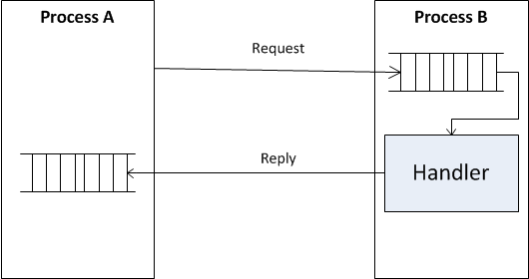
How - Requirements
How to transfer data between processes?
How to identify the queue address of the target service?
How to find the target handler?
How to identify the queue address for the reply?

Slide 5
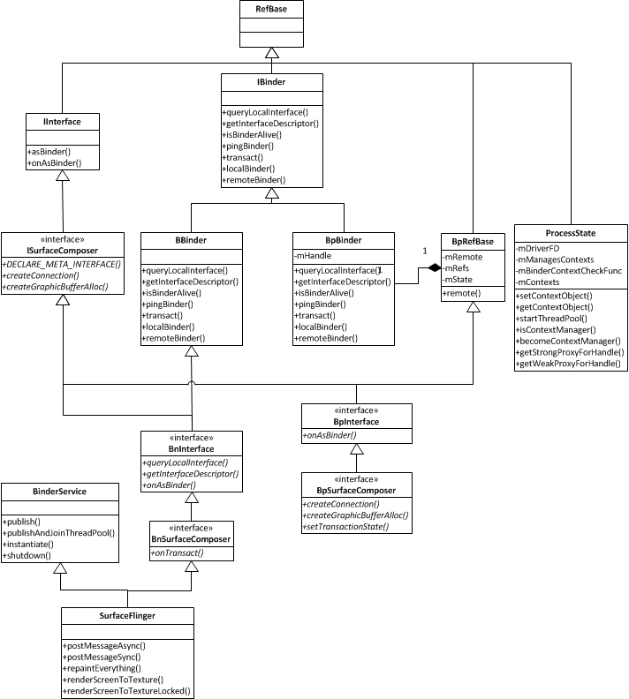
Binder Classes
Client Side: BpXXXX
Server Side: BnXXXX

Slide 6
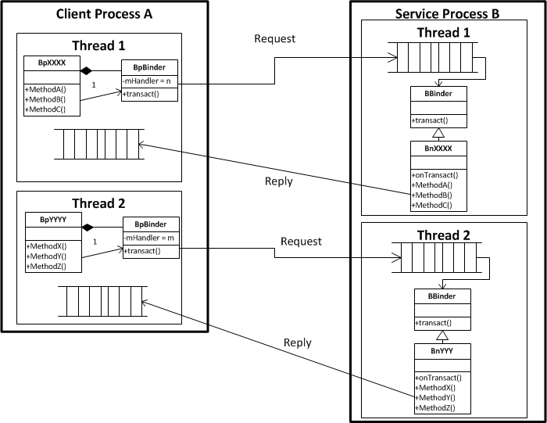
Binder Classes

Slide 7
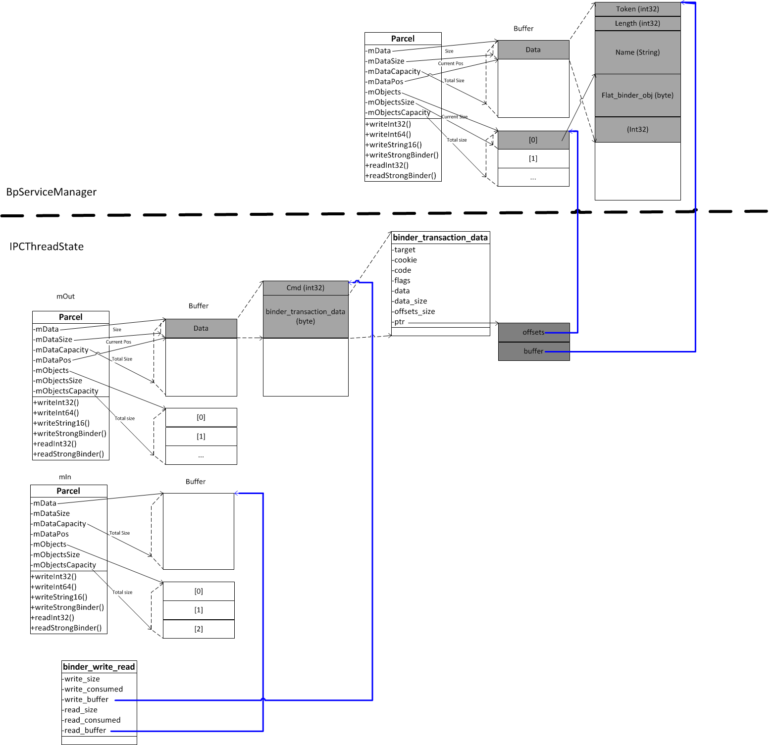
How – Inter Process Data Transition

Slide 8
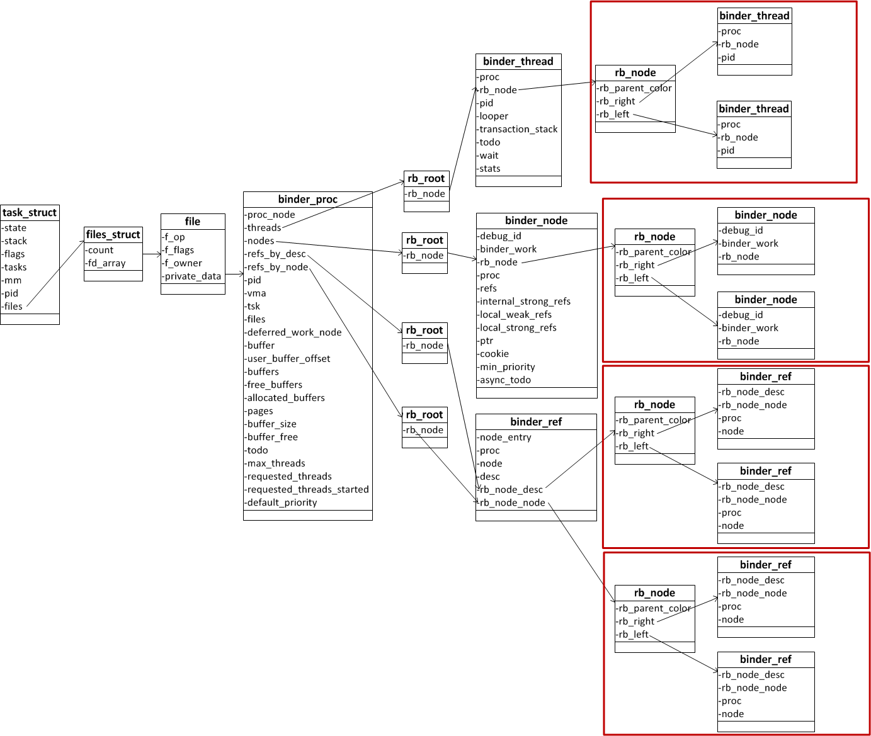
Binder Data Structures in Kernel

Slide 9
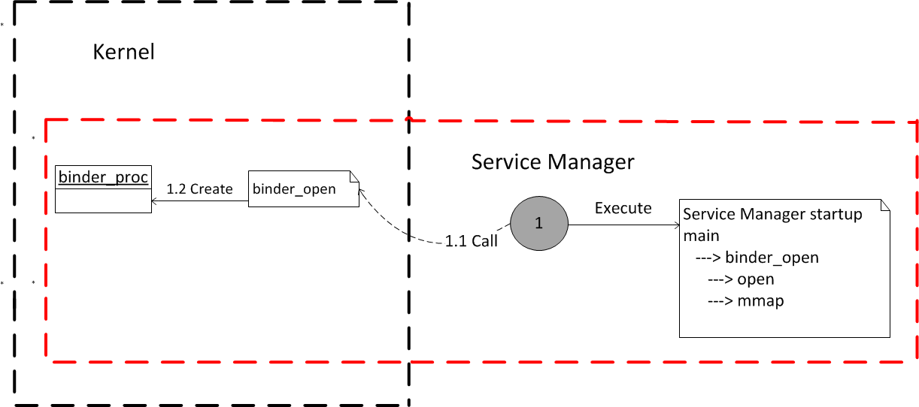
How – Service Manager Startup
Open ‘/dev/binder’ to create binder_proc

Slide 10
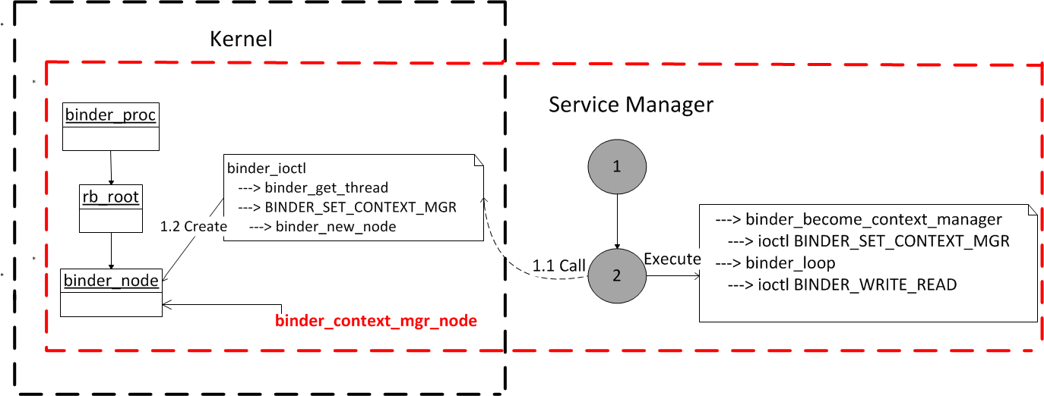
How – Service Manager Startup
Create binder_node to represent Service Manager and make binder_context_mgr_node point to it

Slide 11
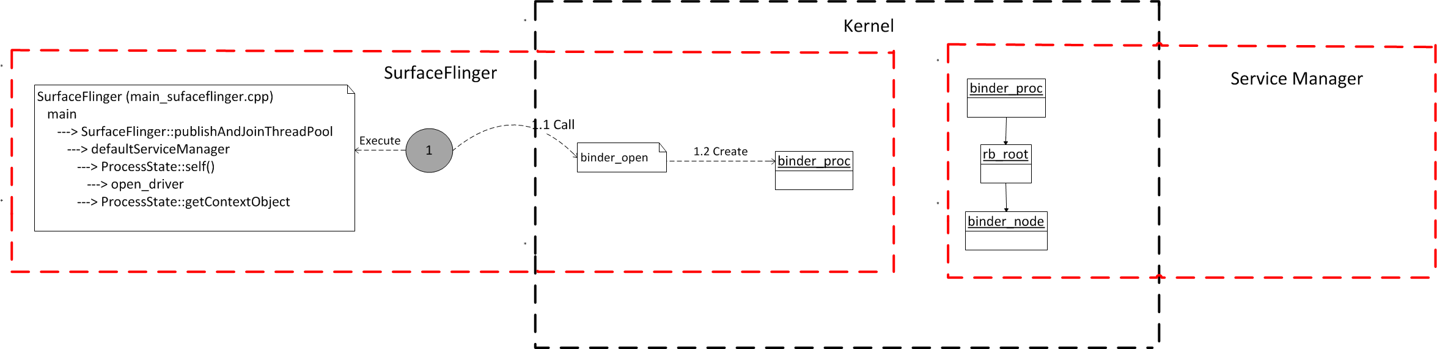
How – Add Service to Service Mgr
Service get the binder proxy object of service manager by defaultServiceManager()

Slide 12
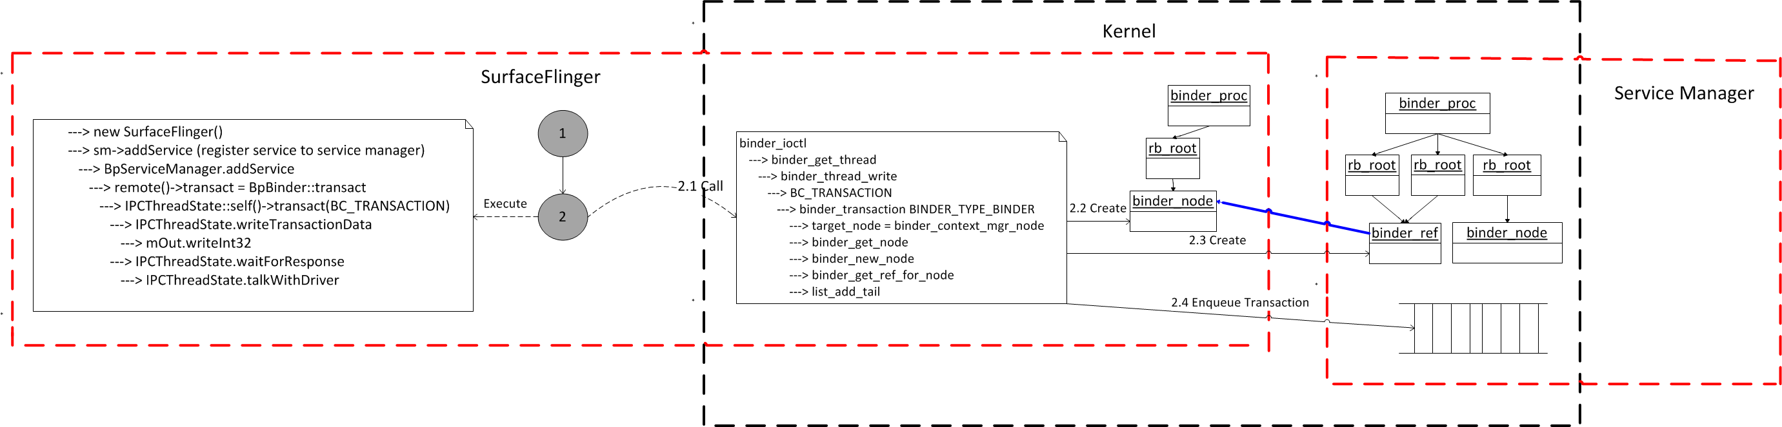
How – Add Service to Service Mgr
Call addService method to register the service to service manager
A binder_node is created in local binder_proc
A binder_ref is created in the binder_proc of service manager

Slide 13
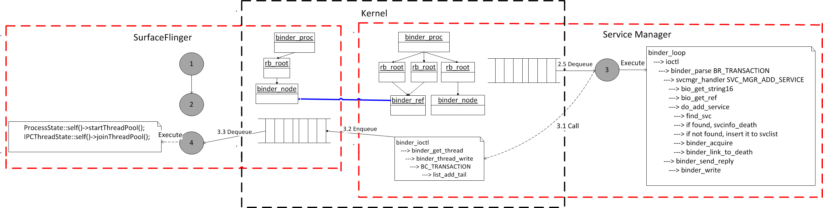
How – Add Service to Service Mgr
Service manager save the information of the service and send back a reply

Slide 14
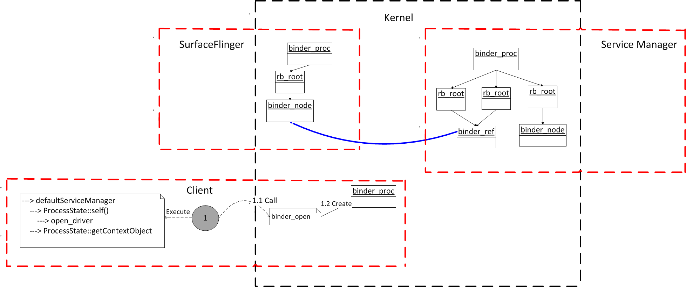
How – Get Service from Service Mgr
Client gets the binder proxy object of service manager by defaultServiceManager()
Binder_proc is created for client process

Slide 15
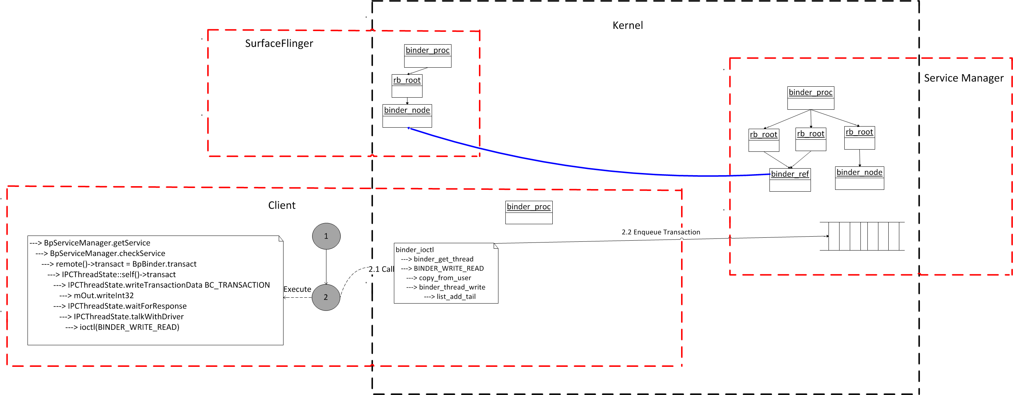
How – Get Service from Service Mgr
Send get service request to service manager

Slide 16
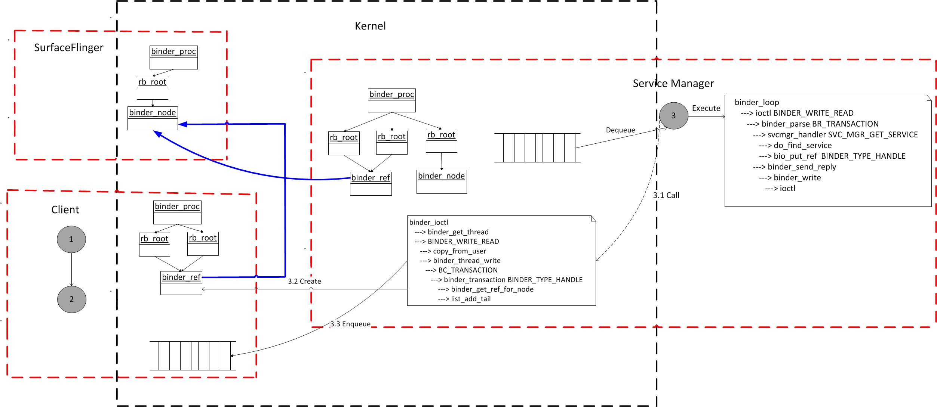
How – Get Service from Service Mgr
Service manager return a reply with the reference of the target service
Binder_ref is created in client

Slide 17
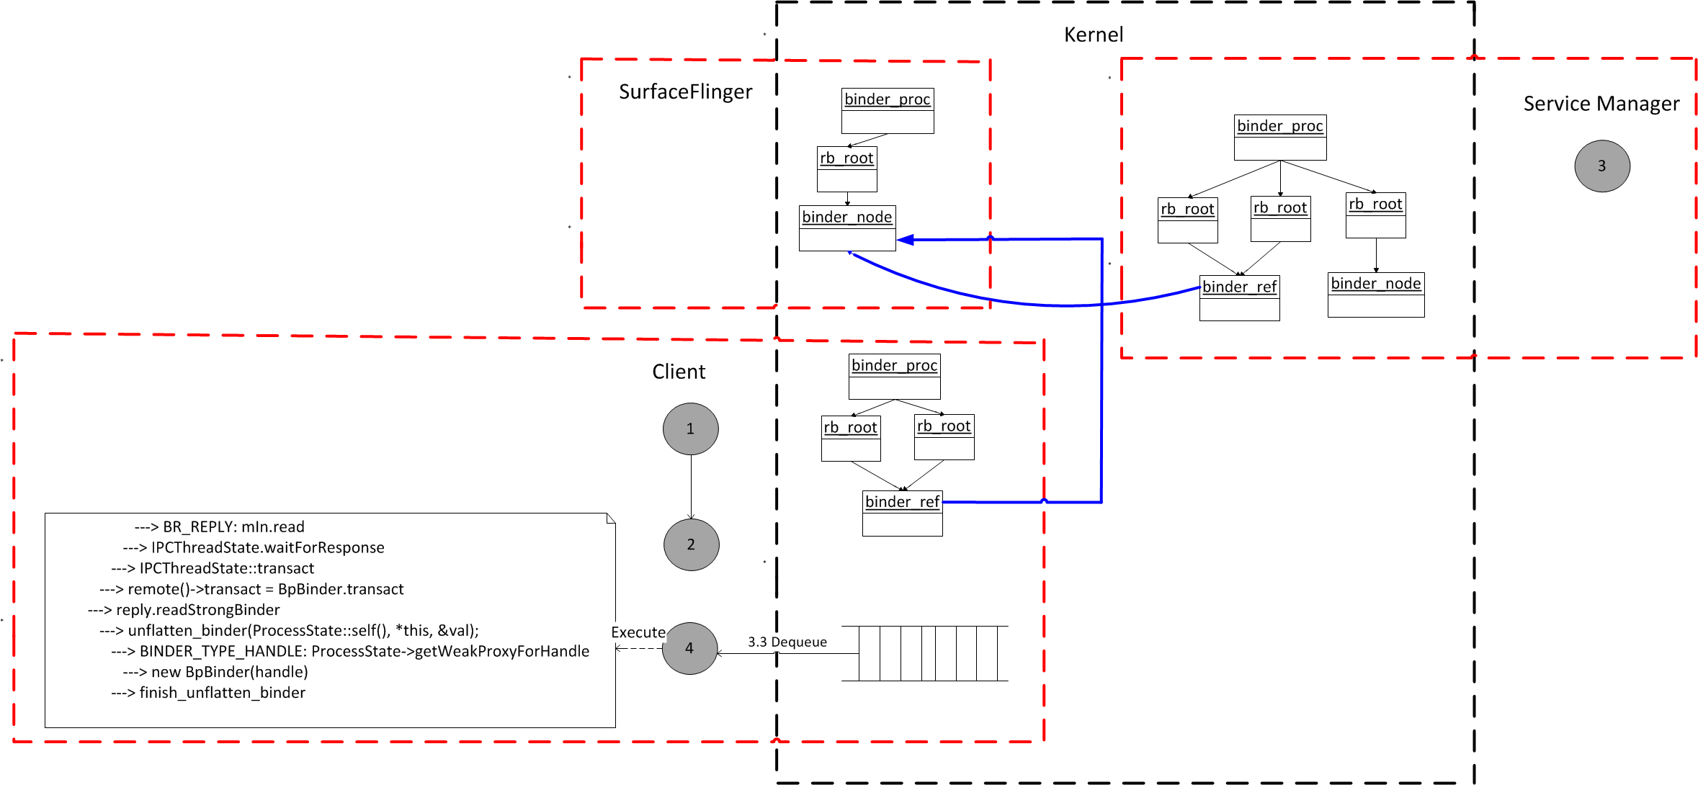
How – Get Service from Service Mgr
Client get the reply from service manager with the reference of the target service
BpBinder is created for target service

Slide 18
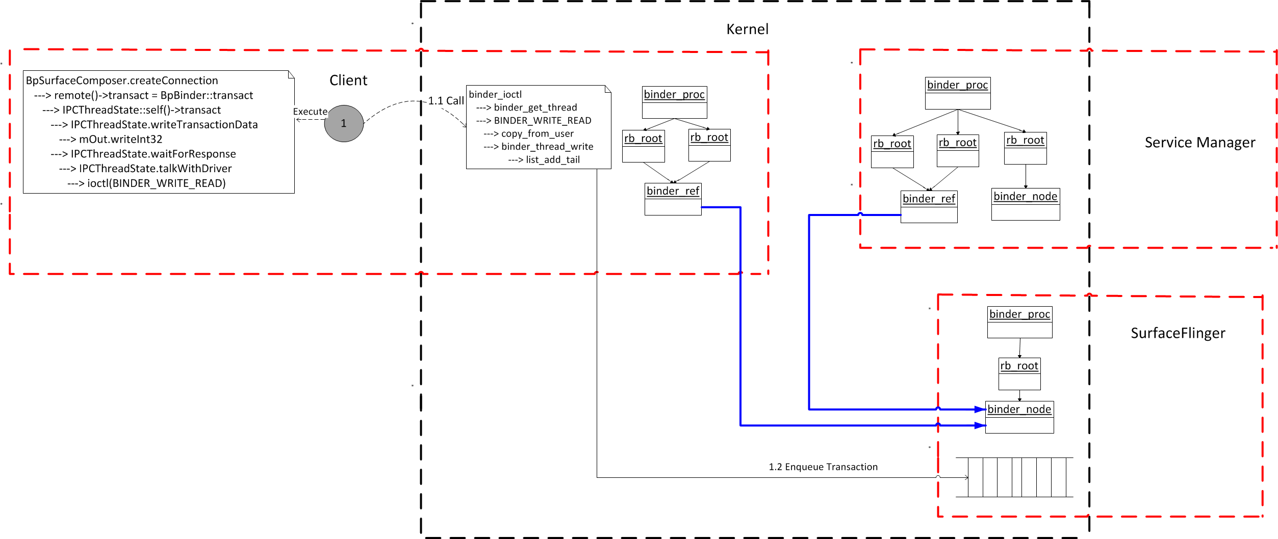
How – Call method of target service
1.1: Find the binder_ref that represents the target binder_node with the reference
1.2: Send request to the queue of target service

Slide 19
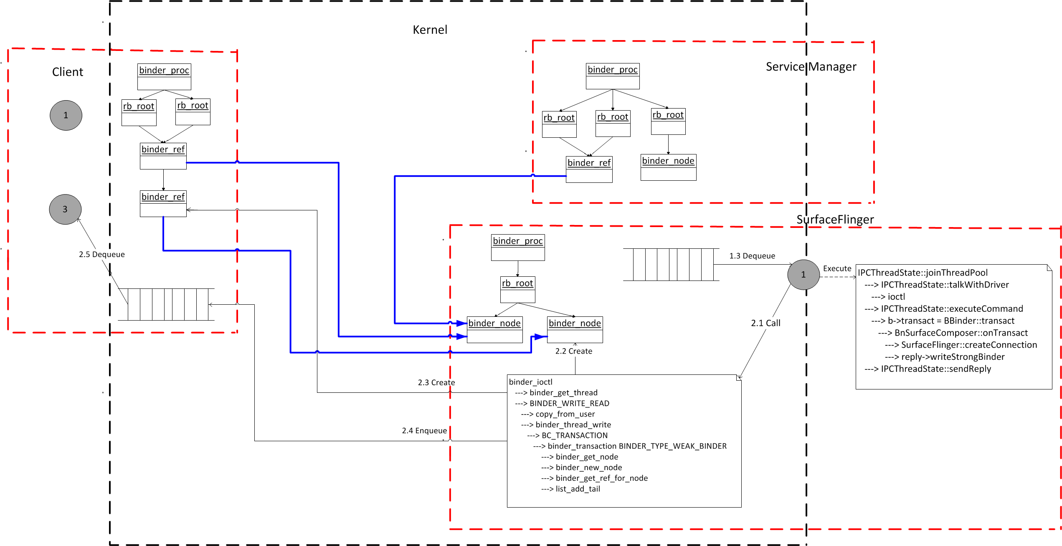
How – Call method of target service
2.1: SurfaceFlinger handles the request and reply with a binder object
2.2: A new binder_node is created in surfaceFlinger
2.3: A new binder_ref is created in client

Slide 20
Thank you!

